Slide 1
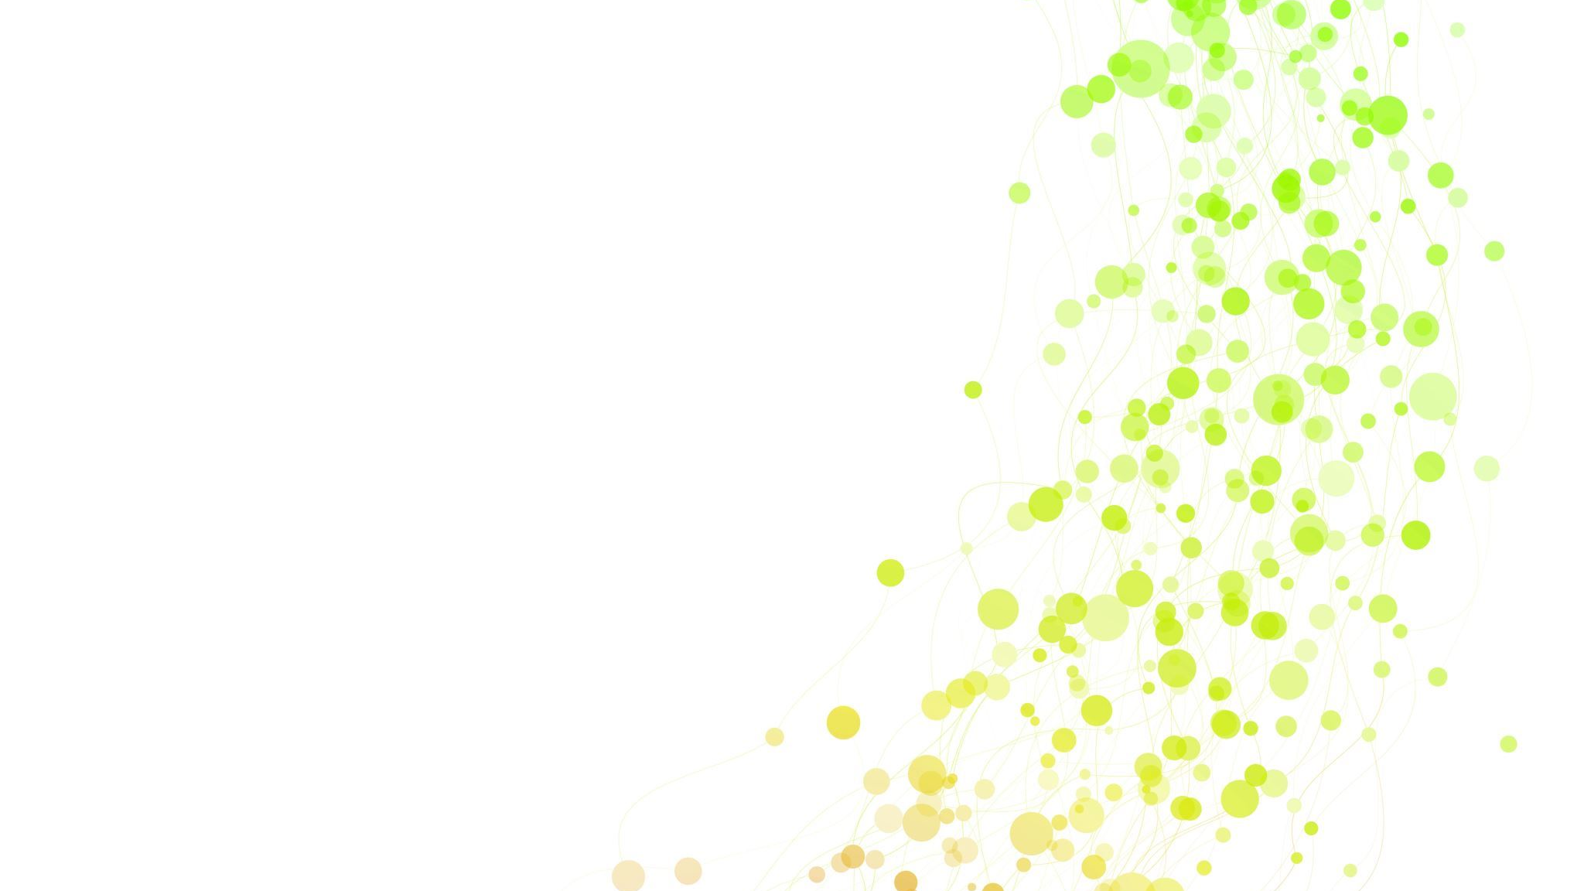
Deterministic Deterministic vs Non-deterministic
By Anjana Shrestha

Slide 2
Algorithm
Algorithm is a set of well-defined instructions in sequence to perform a particular task and achieve the desired output.
On the basis of the knowledge about outcome of the instructions, there are two types of algorithms namely, Deterministic and Non-deterministic Algorithms.

Slide 3
Deterministic Algorithm
A deterministic algorithm is a type of algorithm in which the result of every algorithm is uniquely defined. Hence, a deterministic algorithm performs fixed number of steps and always get finished with accept or reject state with the same result.
Deterministic algorithms can solve a problem in polynomial time. A deterministic algorithm always has a single outcome, i.e. the input given to it always results the same output.
A mathematical function is a common example of the deterministic algorithm.

Slide 4
Non-Deterministic algorithm
A non-deterministic algorithm is one in which the output of every algorithm is not uniquely defined and thus the result could be random. Hence, the non-deterministic algorithms have multiple outcomes.
Non-deterministic algorithms take multiple execution paths, thus it is quite difficult to determine the next state of the machine. Unlike deterministic algorithms, a non-deterministic algorithm cannot solve problems in polynomial time.
Random functions are examples of nondeterministic algorithms.

Slide 5
DIFFERENCE BETWEEN DETERMINISTIC AND NON-DETERMINISTIC ALGORITHM

Slide 6
Execution
In Deterministic Algorithms execution, the target machine executes the same instruction and results same outcome which is not dependent on the way or process in which instruction get executed.
In case of Non-Deterministic Algorithms, the machine executing each operation is allowed to choose any one of these outcomes subjects to a determination condition to be defined later.

Slide 7
Type
On the basis of execution and outcome in case of Deterministic algorithm, they are also classified as reliable algorithms as for a particular input instructions the machine will give always the same output.
Nondeterministic algorithms are classified as non-reliable algorithms for a particular input the machine will give different output on different executions.

Slide 8
Execution time
Deterministic algorithms take a polynomial time for their execution.
Non-Deterministic algorithms cannot get executed in polynomial time.

Slide 9
Execution path
The path of execution for algorithm is same in every execution.
The path of execution is not same for algorithm in every execution and could take any random path for its execution.

Slide 10
Example
Deterministic
Non-deterministic
Q2
Q2
0
0
Q1
0
Q3
Q1
0
1
Q3
Q4

Slide 11
Conclusion
The most significant difference between these two types of algorithms is that a deterministic algorithm has the same path of execution for every execution, whereas a non-deterministic algorithm can take any random path of execution for different executions.

Slide 12


